Slide 1
Biotechnology

Slide 2

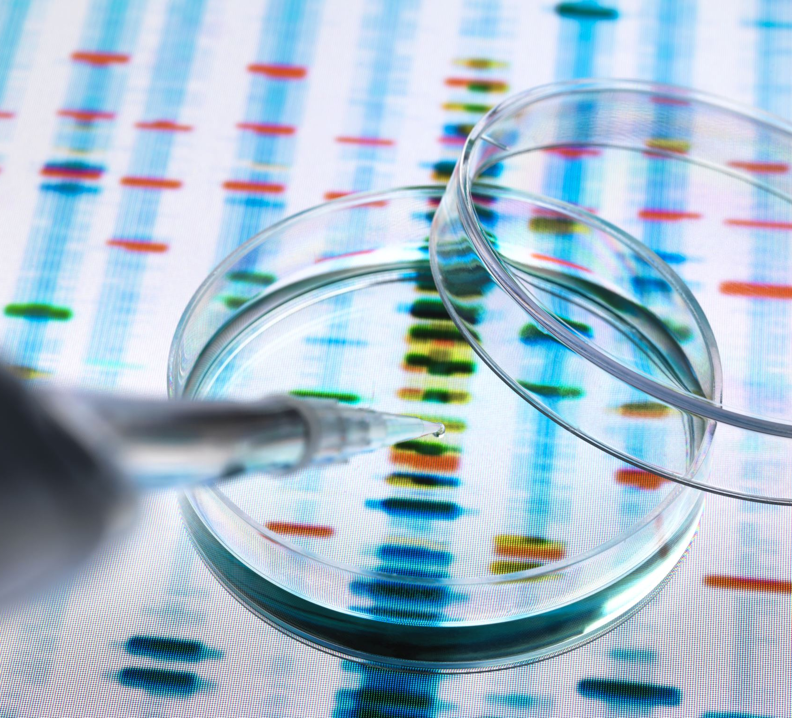
Learning Objectives:
Define and Explain Recombinant DNA Technology
Explain how this technology is currently used.
Explain how biotechnology is used to identify hereditary diseases.

Slide 3
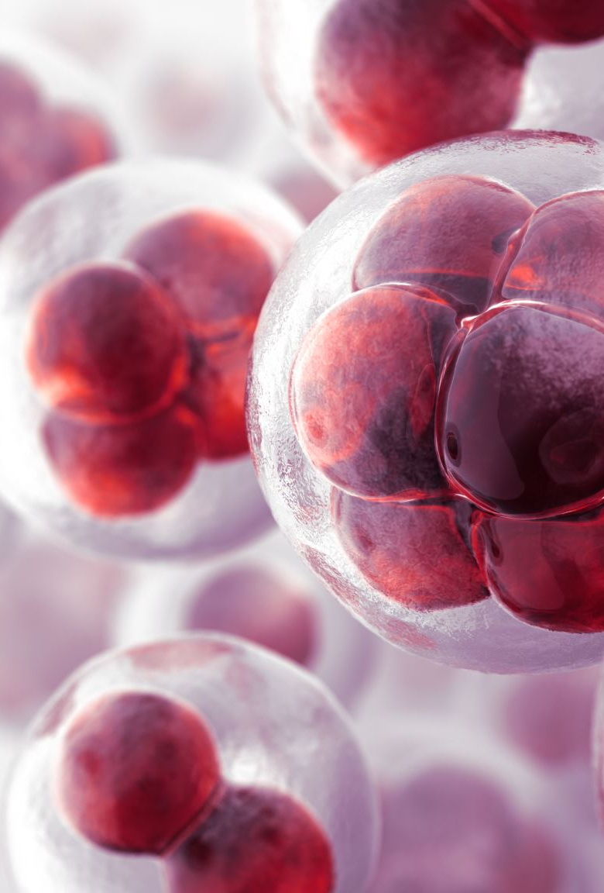
Recombinant DNA Technology
Frequently referred to as genetic engineering- involving the introduction of DNA into cells where the DNA is foreign to that organism or has been modified in some way.
This can be used to take genes from one organism and place them into the chromosomes of another.
This provides potential to replace faulty genes with healthy ones. This same technology also has the potential to identify hereditary diseases.

Slide 4
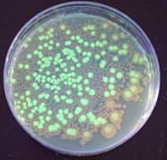
Stanley Cohen and Herbert Boyer invented the recombinant DNA technique in 1973.
Their technique was to isolate and amplify genes or DNA segments and insert them into bacterial cells creating transgenic bacteria.

Slide 5
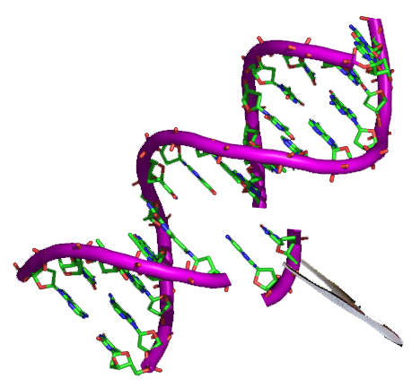
Transgenic organisms are those whose genome has been altered by the transfer of gene(s) from another organism.
These introduced genes then become part of the organism’s DNA and can be passed down.

Slide 6
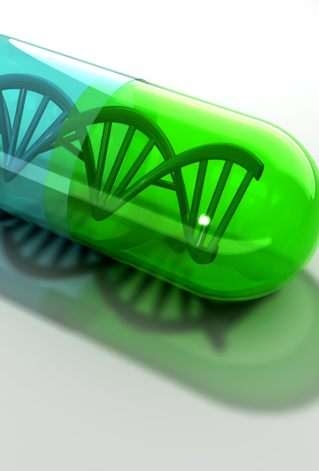
Viruses that infect bacterial cells are called bacteriophages: A key breakthrough in biotechnology was the discovery that certain enzymes in bacteria can restrict the duplication of infecting viruses.
These such enzymes were noted to always cut the DNA at a specific sequence.
This is known as a recognition site and the enzyme that cuts the DNA is a restriction enzyme.

Slide 7
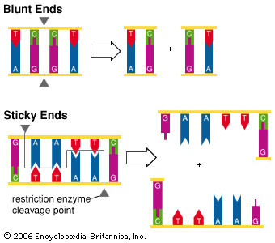
Straight Cut Versus Staggered Cut
Some restriction enzymes produce a straight cut at the sequence while others produce a staggered cut.
A Straight cut is when the restriction enzyme makes a clean break across both strands of DNA to produce a blunt end.
Staggered cut results in sticky ends being cut. A sticky end is a stretch of unpaired nucleotides in the DNA molecule that overhang at the break in strands.

Slide 8
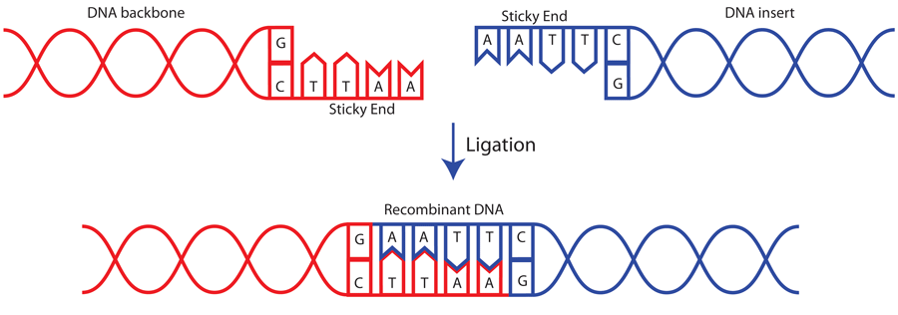
DNA Ligase
Another breakthrough in biotechnology was the discovery of the “DNA-joining enzyme” later named DNA Ligase.
This allows for two sticky ends to be stuck together.
The discovery allowed scientists to attempt recombination experiments in similar DNA and DNA of different species.

Slide 9
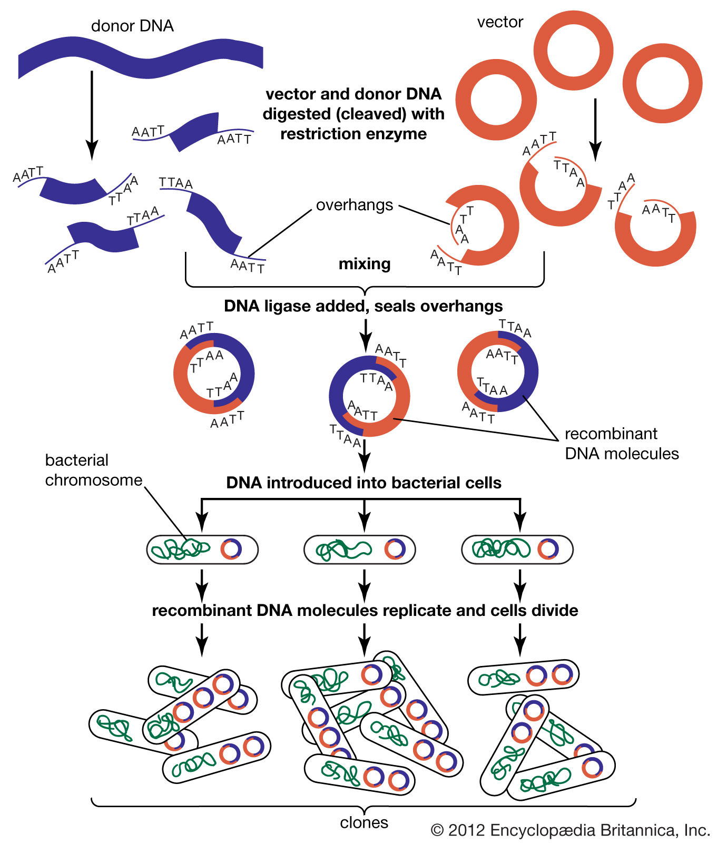
How to produce an organism with recombinant DNA:
Step 1- isolate the Gene of interest
Step 2- the gene is then inserted into a vector and cloned.
The vector now has a segment of DNA capable of replicating on its own.
If the gene of interest is added to a plasmid and then added to a vector, it will replicate and clone with the vector and plasmid- creating numerous copies of the DNA to insert into host cells.
The host cell will then start producing the foreign protein using the instructions in the gene in the recombinant DNA.

Slide 10
Case study 1- Insulin
People with type 1 Diabetes have elevated blood sugar levels due to impaired insulin production by the pancreas.
Insulin regulates the use and storage of glucose.
In 1912- patients were treated with insulin taken from the pancreas of pigs and cattle.
1982- insulin by genetically engineered bacteria was approved for treatment.

Slide 11
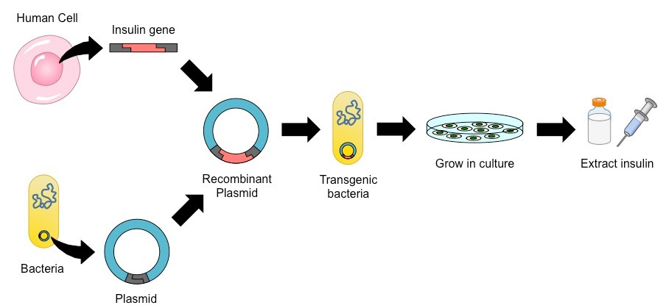
Insulin- Case Study
These bacteria became insulin factories, cultured in vats to produce insulin in bulk.
This was done by using recombinant technology of the human genome and inserting the gene for insulin production into bacterial cells.

Slide 12
Insulin Case Study:
This procedure now frequently performed and uses yeast cells as a growth medium.
Insulin produced this way, also doesn’t have any of the side effects of the pig or cattle harvest insulin.

Slide 13

Case Study 2- Human Growth Hormone
Production of Human Growth Hormone (hGH) has dramatically increased since the use of engineered E. coli bacteria.
This has allowed for enhanced athletic performance and to delay physical deterioration associated with aging, but there is little evidence to support these claims.
It does have the potential to produce serious side effects.

Slide 14
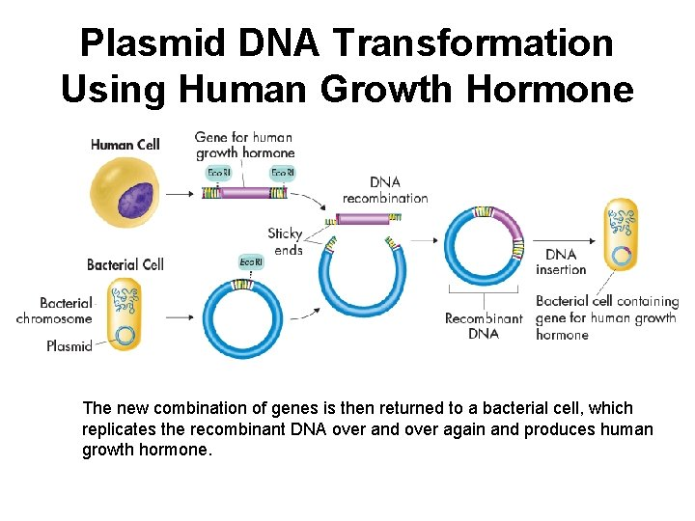
Human Growth Hormone:
This technology was originally used for growth hormone of dairy cattle.
Administrating the hormone increased milk production, and research so far does not have negative health effects

Slide 15
Case Study 3- Factor VIII
Haemophilia A or Classic Haemophilia is an inherited disorder in which the blood clotting protein, Factor VIII, is in little supply or missing.
This means that people with the condition are unable to form blood clots and are therefore at risk of life-threatening bleeding.
To treat this injections of factor VIII concentrates made from human plasma are required.

Slide 16
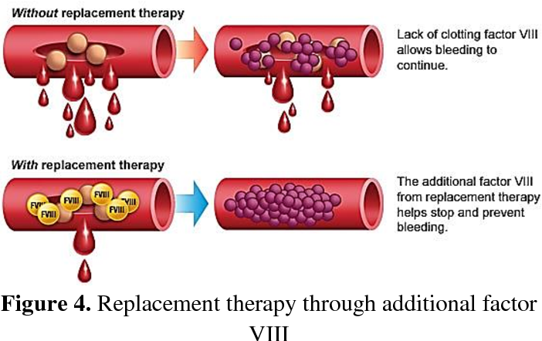
Factor VIII
With the large number of donors required, there is constant risk of a viral disease transmission- that would be fatal to those with haemophilia A.
The two big ones being Human Immunodeficiency Virus and Hepatitis C
Recombinant DNA overcame this risk though and is also free of other plasma proteins that would trigger an immune response.

Slide 17
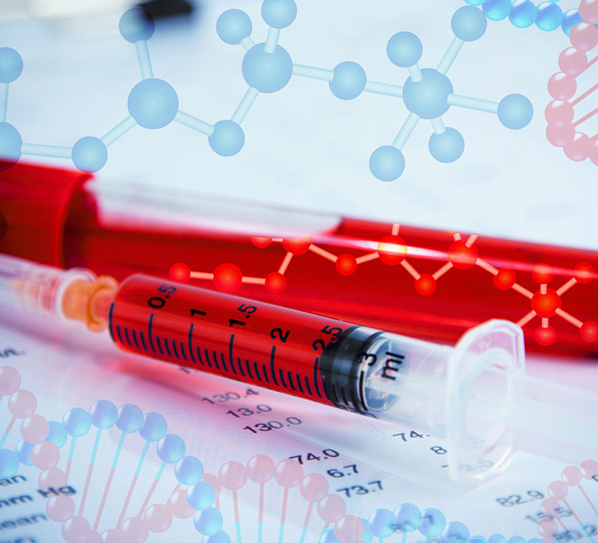
Factor VIII
Factor VIII is now one of the largest molecules synthesized and is cultured in Mammalian cells- proving to be highly effective in controlling excessive bleeding.

Slide 18
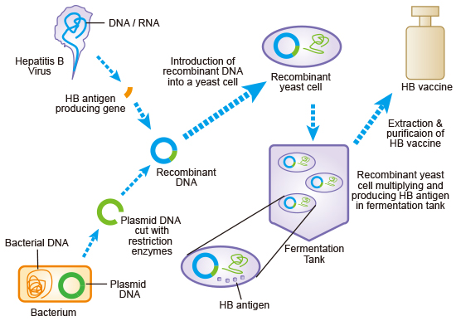
Case Study 4- Vaccines
The first vaccine for human use produced using recombinant DNA technology was for Hepatitis B (1986)
Produced by inserting the gene from the Hepatitis B virus into the cowpox virus.
This method of vaccine production is very expensive though.

Slide 19
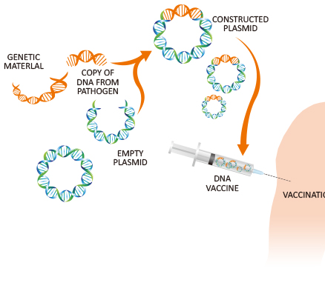
Vaccines:
For a vaccine to be developed in this manner:
The genes for the desired antigens must be located
The genes then must be cloned
The cloned genes then must be expressed efficiently in a new vector

Slide 20
Vaccines:
Besides the financial deterrent, those involved in vaccine research also need to be conservative.
Due to vaccines being used on healthy people, especially children, safety is paramount.
Therefore, if a vaccine works there is little incentive to invent a new one.

Slide 21
Identifying Hereditary Diseases
Hereditary diseases are caused by defective genetic information being transmitted from parents to their children.
Usually, genes produce normal characteristics, however, genes can suddenly change from the normal structure.
This is referred to as causing mutations.

Slide 22
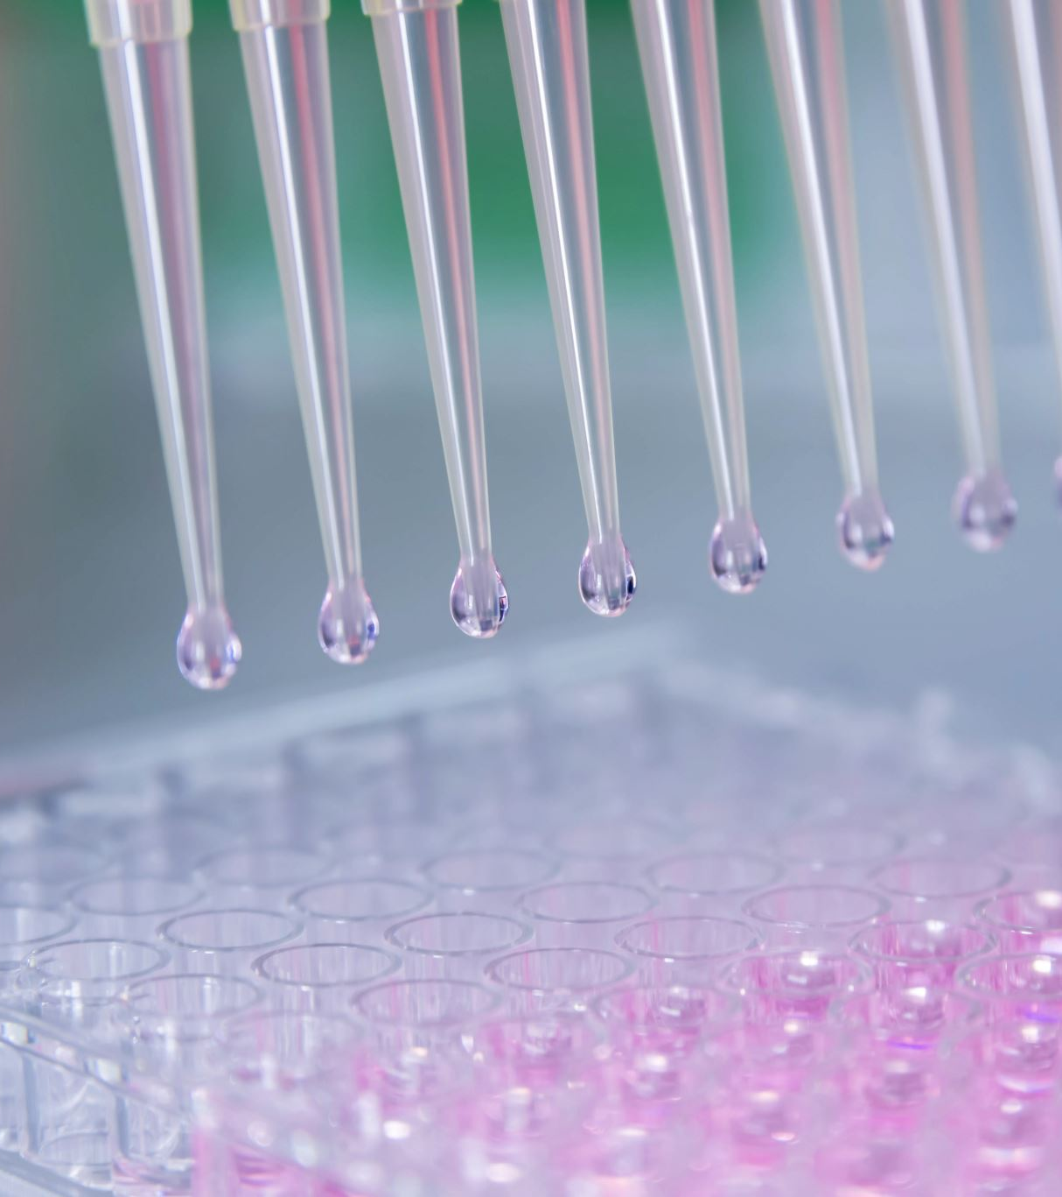
Frequently, mutant genes function improperly and cause disorder or change to structure of the body and can even be passed onto future generations.
Advances in biotechnology allow use to identify diseases/ disorders caused by mutant genes.
There are major risks and ethical concerns behind these.

Slide 23
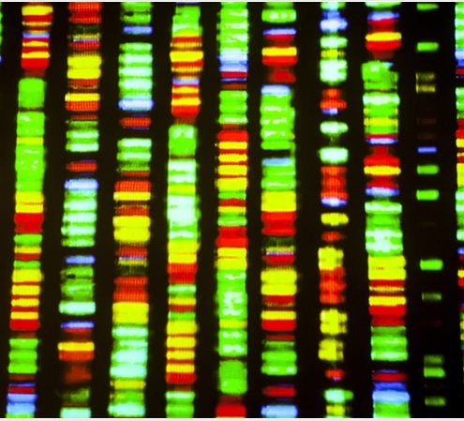
DNA Sequencing
Determines the precise order of nucleotides in a sample of DNA
Enables sequences to be compared easily.

Slide 24
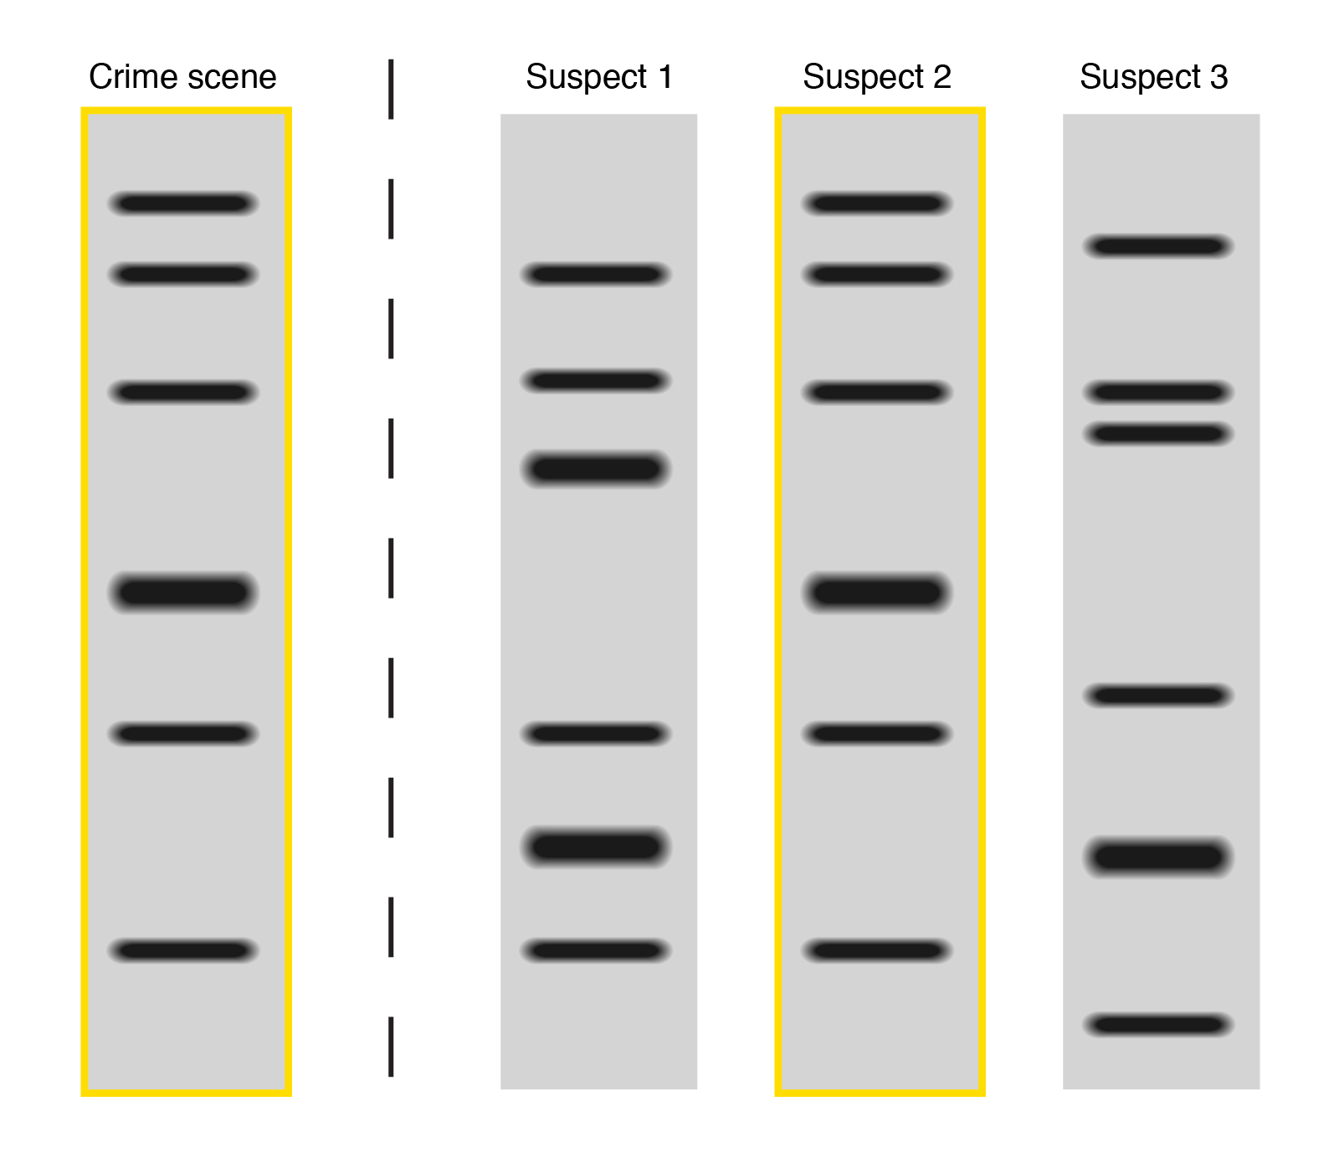
Profiling
Determines an individual’s DNA profile or fingerprint as a distinct series of bands
Enables detection of many genetically inherited diseases

Slide 25
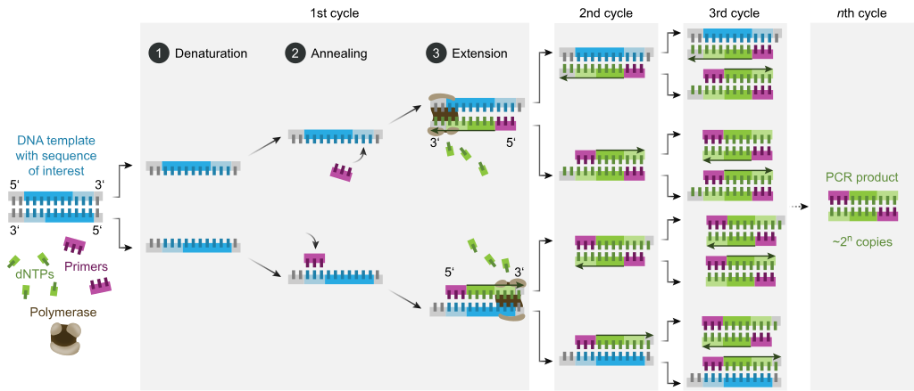
Polymerase Chain Reaction:
Segments of DNA are manipulated through a series of repeated cycles using an enzyme called DNA polymerase
Genes of interest can easily be amplified and then sequenced to detect the mutations.

Slide 26
Extend Your Knowledge Research:
How is recombinant DNA is contributing to the manufacture of new vaccines?
The difficulties involved in the use of such a technique
Which vaccines are now produced using recombinant technology?
OR: Private Study for test your test on Friday.

